Slide 1
Precision Temperature sensing options for the Radium Thermo Cycler
Background:
The Radium Real time PCR instrument requires a precise, stable, long life thermal sensor for the PID control system as used for the Thermo Cycler.
The Perfect Temperature Sensor:
• Has no effect on the medium it measures.
• Sensor is precisely accurate?
• Responds instantly (in most cases).
• Has an easily conditioned output.

Slide 2
Comparing NTC/RTDs
Sensor | NTC Thermistor Semiconductor | RTD Thermocouple Platinum
Sensing Technology | Sensor Ceramic (metal oxide spinel) | Platinum wirewound or metal film
Temperature Range (typical) | -100 to +325˚C | -200 to +650˚C
Accuracy(typical) | 0.05 to 1.5 ˚C | 0.1 to 1.0˚C
Long-term Stability @ 100˚C(typical) | 0.2˚C/year (epoxy) 0.02˚C/year (glass) | 0.05˚C/year (film) 0.002˚C/year(wire)
Output | NTC Resistance : -4.4%/˚C typical | PTC resistance: 0.00385Ω/Ω/°C
Linearity | Exponential | Fairly linear
Power Required | Constant voltage or current | Constant voltage or current
Response Time Fast | 0.12 to 10 seconds | Generally slow 1 to 50 seconds
Susceptibility to Electrical Noise | Rarely susceptible (High resistance only) | Rarely susceptible
Lead Resistance Effects | Low resistance parts only | Very susceptible. 3 or 4-wire configurations required
Cost | Low to moderate | Wire-wound – High Film – Low
Advantages | • Sensitivity (High) • Accuracy (High) • Cost (low to high) • Rugged (high) • Flexible (good) •Packages (several options) • Hermetic Seal ? | • Accuracy (Good) • Stability (High) • Linearity (Fair)
Disadvantages | • Non-linearity • Self-heating • Moisture failures (non-glass only) | • Lead resistance error • Response time • Vibration resistance • Size • Package limitations

Slide 3
Thermal sensor notes.(Limited to thermistors and RTDs)
Thermistors and RTDs differ in their basic theory of operation.
Temperature ranges vary for each sensor technology .
Accuracy depends upon basic sensor characteristics. Both Platinum elements and thermistors exhibit high accuracy. Generally the better the accuracy, the higher the price.
Long-term stability is defined by how consistently a sensor maintains its accuracy over time. Stability is dictated by basic physical properties of the sensor.
Stability is typically worsened by exposure to high temperatures. Wirewound platinum and glass encapsulated thermistors are the most stable sensor types.
Thermistors change resistance inversely proportionally with temperature, thus the name negative temperature coefficient (NTC).
Base metals such as platinum have positive temperature coefficients (PTC). Thermistors are exponentially non-linear, exhibiting a much higher sensitivity at low
temperatures than at high temperatures.
Linearity of a sensor has become less of an issue over time, as microprocessors are more widely used in sensor signal conditioning circuits.
When powering, both thermistors and platinum elements require constant voltage or constant currents. Power regulation is important to limit self-heat in either
thermistors or platinum RTDs.
Response time, or how quickly a sensor indicates temperature, is dependent on the size and mass of the sensor element (assuming no predictive method is used).
Platinum wirewound elements are slow at responding. Platinum film and thermistors are available in small packages, thus have high-speed options. Glass micro-beads are the fastest responding thermistor configuration. Electrical noise inducing errors in temperature indication is a problem mostly with Thermistors with very high resistances may present a problem in some cases.
Lead resistance may cause an error offset in thermistors and RTDs. This effect is more pronounced with low resistance devices such as 100Ω platinum elements or low resistance thermistors. For platinum, 3 or 4-wire lead configurations are used to eliminate the problem. For thermistors, typically choosing a higher resistance value eliminates the effect.

Slide 4
Requirements for Temperature sensing for Radium
Key requirements for a thermal sensor:
Stability throughout product life cycle. (Working with vendors to define a suitable specification.)
a. The thermal sensor resistance value shall not deviate more than +/- 0.xx % through the service life of the thermal sensor.
2. Response time(thermal time constant). Preferably <1 second in air.
a. The thermal sensor response shall stabilize within within 1 second in air. (This may be too tight)
b. Dissipation Constant < 1mW/C (YSI 44036 has specified 1mW for a dissipation constant. GE AB0E8-BR23KA103N is 0.38 is rated at 0.38mW/C)
5. Maximum power dissipation as related to self heating.(Both NTC’s and RTD’s exhibit this).
a. Maximum error(uncertainty) in temperature measurement due to self heating.(TBD)
b. T(error) = Power Dissipation/Dissipation Constant(Te= P/dTh) (TBD)
Mounting:
1. Two thermal sensors will be surface mounted with in grooves adjacent to the Peltier device(s) on a given Thermo Cycler plate.
2. Thermal mass and encapsulant:
a. Materials/epoxy/Glass TBD>

Slide 5
Sensor Manufacturer Questions to date
From US Sensors
What is the maximum temperature that the sensor will be exposed to?
* Over what temperature range will measurements be taken, and is there a portion of this temperature range that is most critical?
If a portion is most critical, what is this critical temperature range?
* What temperature accuracy is required over this critical temperature range?
* How long should the lead wires be?
* Is a simple leaded component or a complete probe assembly required?
If a probe assembly:
* What style of probe housing is envisioned? (e.g. straight tube, straight tube with NPT fitting, etc.)
* What are the size limitations for the probe housing? (e.g. tube length, tube diameter, etc.)
* What material should the probe housing be made from? (e.g. stainless steel, brass, etc.)
* What quantities would be purchased?

Slide 6
Sensor Manufacturer Questions to date
From QTI
There is no tolerance or accuracy figure called out; is this unnecessary because Gen-Probe will be calibrating all sensors individually? Or would you prefer a precision sensor that did not require calibration and thus eliminate that extra expense?
There is no specification on element size.
Mass can greatly determine response time but your requirement is only that it “will have a response <1 second in air.” Does this mean that the element is expected to read final temperature in less than a second or, per MIL-PRF 23648 which QTI uses for its milspec parts: “ The thermal time constant is the time required for a thermistor to change to 63.2 percent of the total difference between its initial and final body temperature when subjected to a step function change in temperature under zero power conditions”?
What is the primary “driver” of your decision on a sensor? Is it simply the lowest cost for the most stable device? If so, what kind of data do you need to see in order to make a selection? Or do you just need a quotation?
These are some of the parameters we would like to establish. And although you may have received multiple quotations for this part, I tend to think they are not all describing the same identical device based upon my previous questions. We just want to be sure we’re quoting “apples to apples”.

Slide 7
Sensor Manufacturer Questions to date
From Measurement Specialist
Regarding the time response. We presume you mean time constant of 1 second in still air. This would would dictate a small bead (0.013”). These are often (but not always) axially leaded—that is, the leads are out the opposite side of the element. Are you looking for this or for radial leads (which come out the same side of the part)?
Also, there is no resistance given. We understand this to mean that you are open to suggestion, but do you have limits? Can you use a 100Ω part, or a 1,000,000Ω part? We’re not suggesting that we would recommend those values; we just want to get a handle on what you consider optimum and can live with.
The small beads typically have platinum leads .001” diameter and .312” long. We cannot make them with significantly longer leads; however, if it is a radially leaded part we can weld the leads to, for example, a nickel bifilar wire, which will have a little more stiffness.
If we had a little more application information it might prove useful—such as the mechanical configuration you are looking to measure. Also, the temperatures you expect—will the part be constantly cycling? How often will it see the 110°C top end?

Slide 8
Sensor Manufacturer Quotes

Slide 9
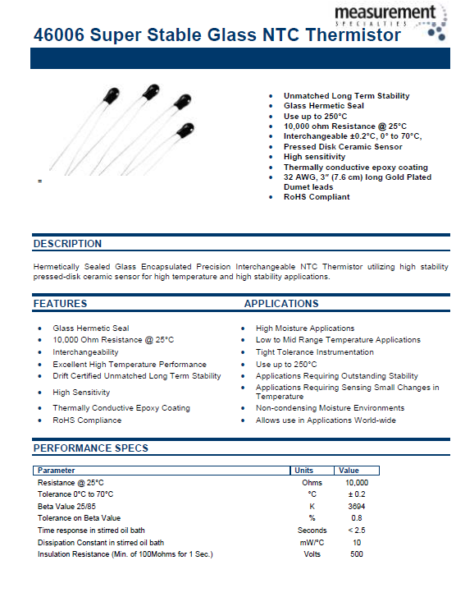
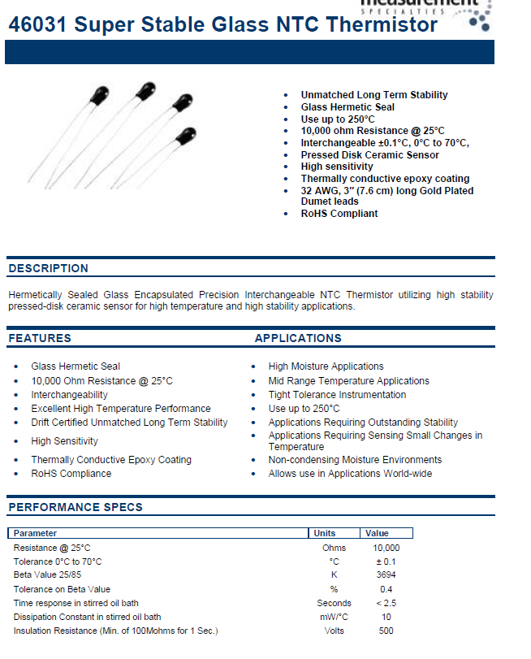
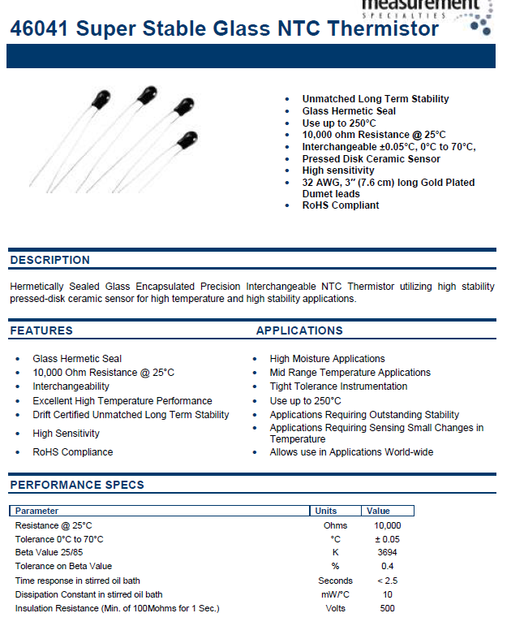
YSI Data Sheets(0.2C, 0.1C, and 0.05C accuaracy)

Slide 10
Sensor Manufacturer Quotes(YSI)

Slide 11
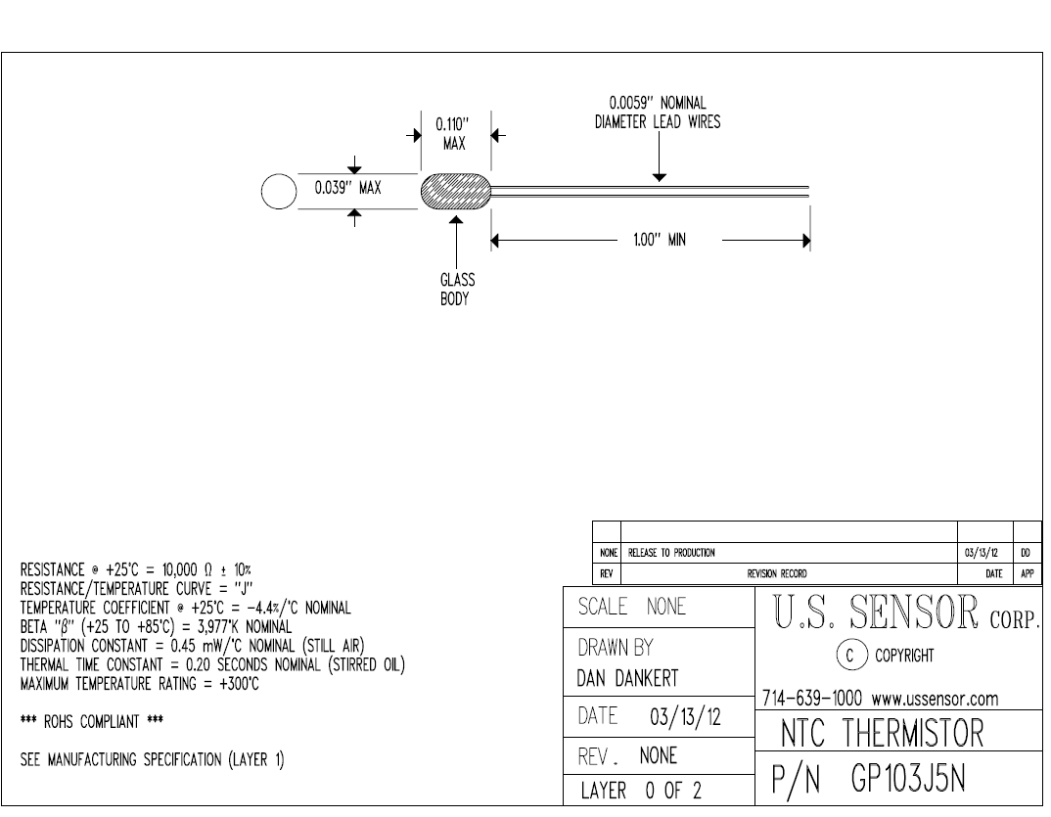
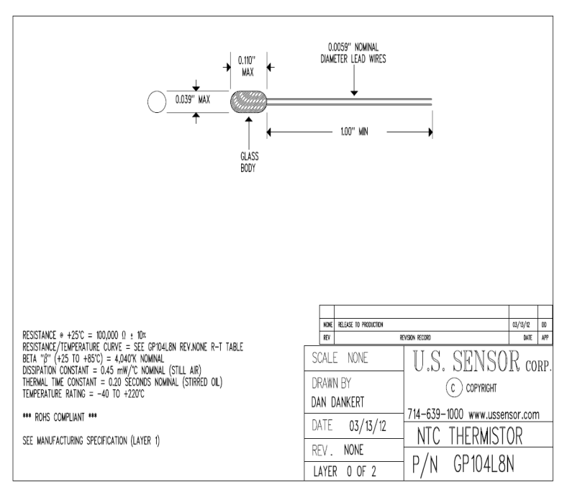
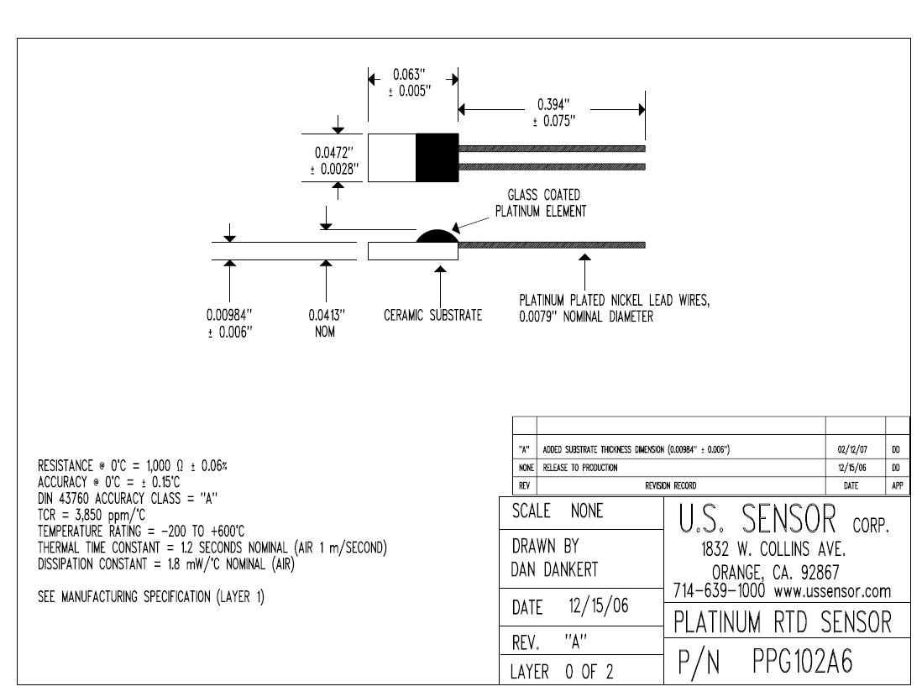
US Sensor Data Sheets(accuracy ?)

Slide 12
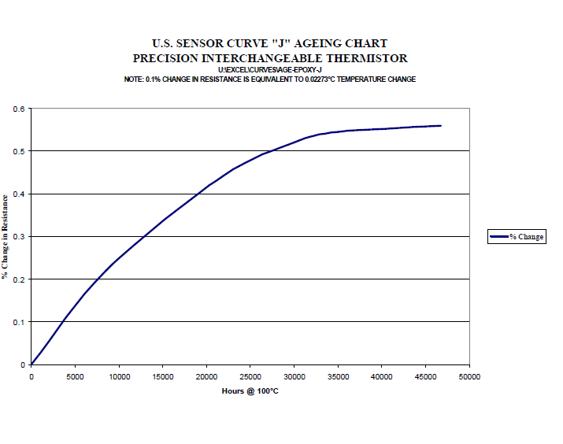
Aging Curve for Epoxy Encapsulated Thermistor

Slide 13
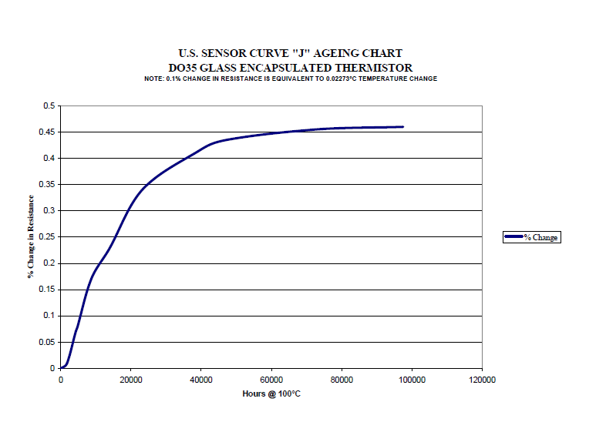
Aging Curve for Glass Encapsulated Thermistor

Slide 14
Sensor Manufacturer Quotes (US Sensor)

Slide 15

Thermistor Calculations
Calculations for Temperature and Thermistor Applications
http://www.thermistor.com/calculators.php
Beta Value Calculator - The approximate relationship between the resistance and temperature for a NTC thermistor. R – T (Resistance vs. Temperature Tables) – A table showing the standard resistance at each temperature point.
Steinhart-Hart Calculator - The Steinhart–Hart equation is a model of the resistance of a semiconductor at different temperatures.
Where: T is the temperature (in kelvins)
R is the resistance at T (in ohms)
A, B, and C are the Steinhart-Hart coefficients which vary depending on the type and model of thermistor and the temperature range of interest. (The most general form of the applied equation contains a (ln(R))2 term, but this is frequently neglected because it is typically much smaller than the other coefficients, and is therefore not shown above.)

Slide 17
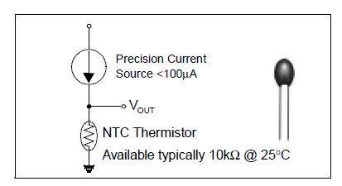
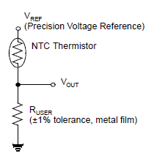
Thermistor Powering
Current Source
Voltage Source

Slide 18
High Reliability Thermistor Manufacturers
QTI
www.thermistor.com QTI Have space grade and military grade parts.
http://www.thermistor.com/productsNTCElementsSpace.php
http://www.thermistor.com/productDetails.php?prodID=56
Measurement Specialist
http://www.meas-spec.com/temperature-sensors.aspx
http://www.meas-spec.com/temperature-sensors/ntc-thermistor-sensors/ntc-space-qualified-hi-rel-thermistors.aspx () Have space grade and military grade parts
US Sensor
www.ussensor.com
Omega
www.omega.com/prodinfo/thermistor.html

Slide 19
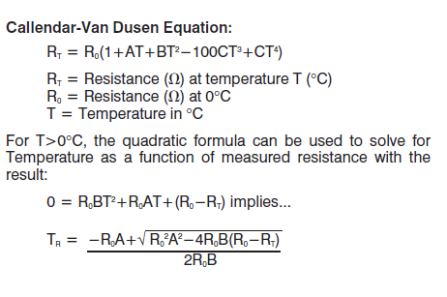
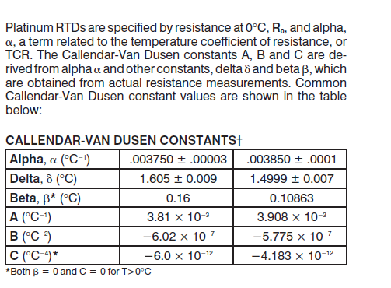
RTD Calculations

Slide 20
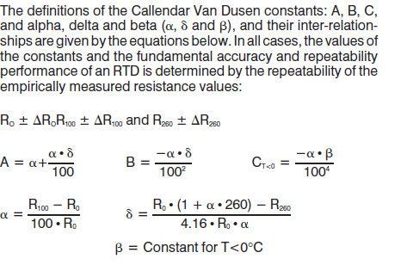
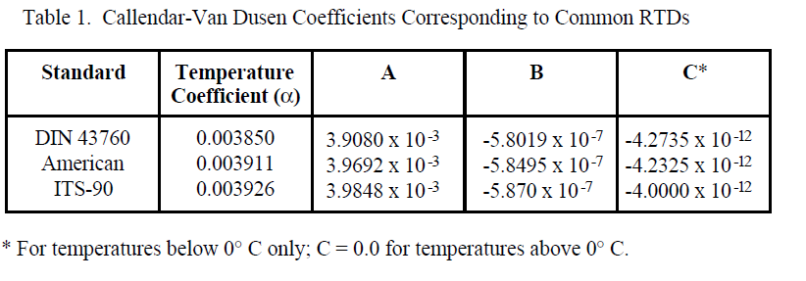
RTD Calculations Continued

Slide 21
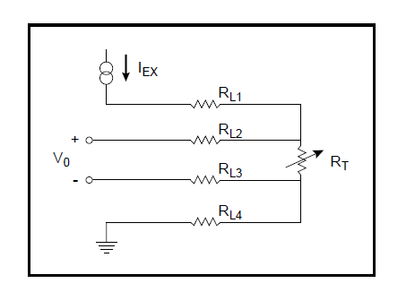
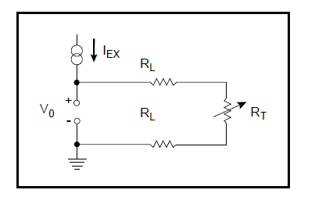
RTD Circuit Powering Examples

Slide 22
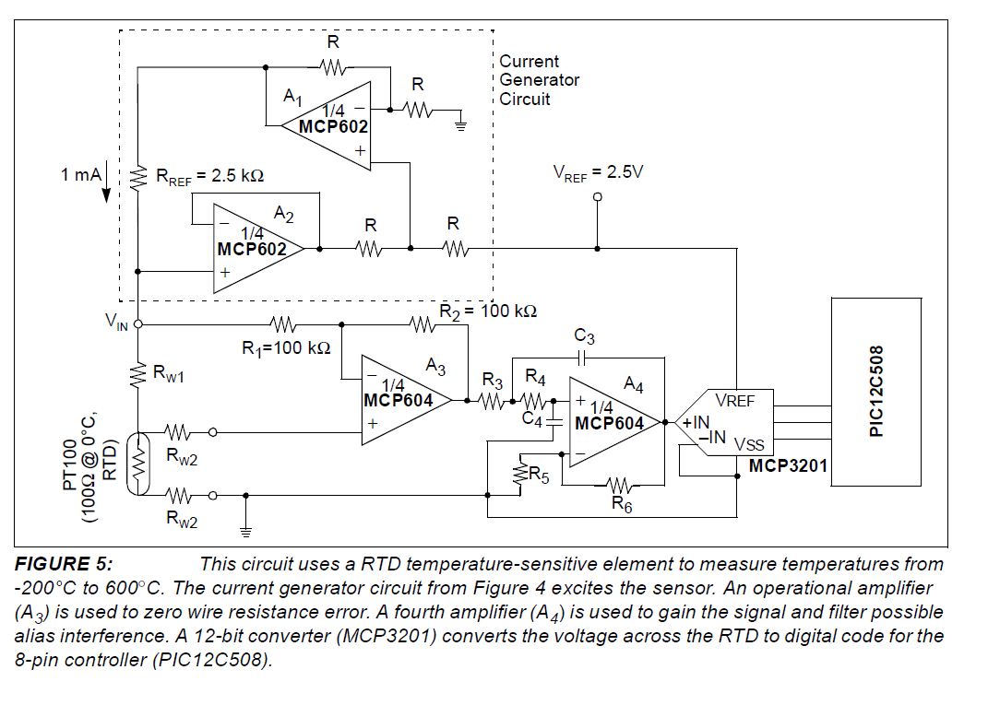
RTD Analog Front End Example

Slide 23
RTD Manufacturers/Suppliers
Measurement Specialist
http://www.meas-spec.com/temperature-sensors.aspx
QTI
http://www.thermistor.com/productsRTDsLeaded.php
RdF
http://www.rdfcorp.com/products/surface_rtds/r-scaplc_01.shtml
http://www.rdfcorp.com/products/capsule/r-mini_01.shtml
Omega
http://www.omega.com/
Honeywell
http://content.honeywell.com/sensing/prodinfo
Burns Engineering
http://www.burnsengineering.com/

Slide 24
References
RTD App Notes
http://www.rdfcorp.com/anotes/pa-rtd/pa-rtd_01.shtml
http://www.omega.com/temperature/z/pdf/z033-035.pdf
http://content.honeywell.com/sensing/prodinfo/temperature/technical/c15_136.pdf
http://ww1.microchip.com/downloads/en/appnotes/00687b.pdf

